Slide 1
Introduction to Computing
ENGR. SAJID SALEEM

Slide 2
Outline
Arithmetic expression
Output Numbers (Literal Constants) (cout << 2 << endl;)
Arithmetic Operators (+, -, *, /, %)
Defining Expression/Arithmetic Expression
Operator Precedence & Associativity
Arithmetic Expression evaluation
Output value of an Arithmetic Expression (cout << 2*3 << endl;)
Problem Solving using Arithmetic Expression (literal constants

Slide 3
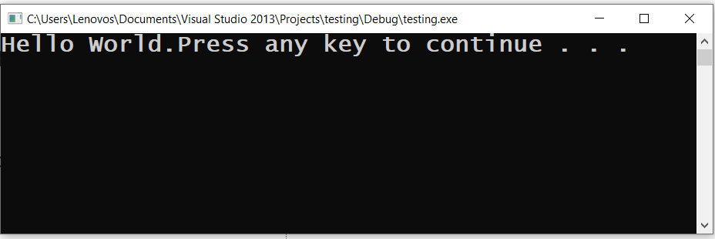
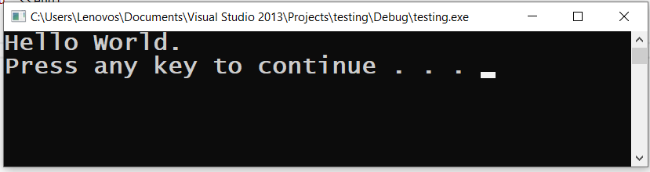
First steps in C++
#include<iostream>
using namespace std;
int main()
{
cout << "Hello World.";
//cout << "Hello World."<< endl;
system("pause");
return 0;
}
//cout << "Hello World.";
cout << "Hello World."<< endl;

Slide 4
First steps in C++ (comments, keywords, identifiers)
Comments
Single Line : // This is a single line comment
Multiple line: /* This is a multi line comment that uses forward slash combined with steric */
Keywords
int, float, double, char, const, void, return
Identifiers
A C++ identifier consists of letters, digits, and the underscore character (_ ) and must begin with a letter or underscore.
Like variables, constants and functions

Slide 5
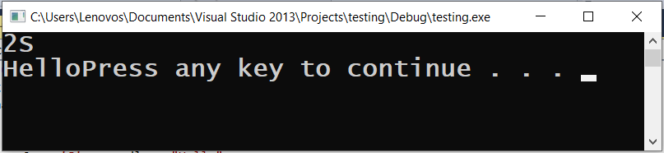
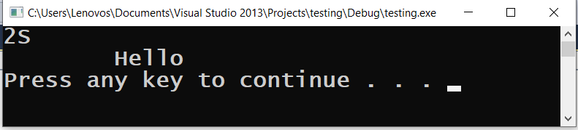
First steps in C++ (constants, char, string)
#include<iostream>
using namespace std;
int main()
{
cout << 2 << 'S' << endl << "Hello";
//cout << 2;
//cout << 'S';
//cout << endl;
//cout << "\tHello\n";
system("pause");
return 0;
}
//cout << 2 << 'S' << endl << "Hello";
cout << 2;
cout << 'S';
cout << endl;
cout << "\tHello\n";

Slide 6
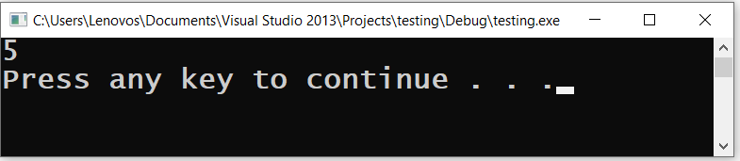
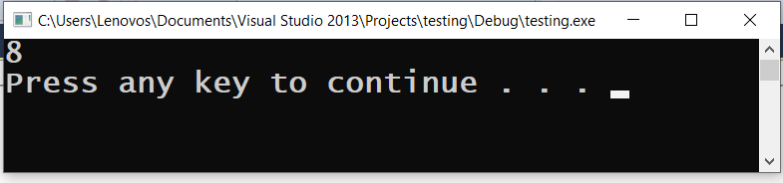
First steps in C++ (Arithmetic operator & precedence)
#include<iostream>
using namespace std;
int main()
{
cout << 2 + 3 <<endl;
//cout << 2 + 3 * 4 / 2 << endl;
system("pause");
return 0;
}
//cout << 2 + 3 <<endl;
cout << 2 + 3 * 4 / 2 << endl;

Slide 7
THANK YOU

